Slide 1
WHITE BOX CARTOONIZATION USING
AN EXTENDED GAN FRAMEWORK
Mini- Project
Project by:
AMEY THAKUR | TE COMPS B-50 | TU3F1819127
HASAN RIZVI | TE COMPS B-51 | TU3F1819130
MEGA SATISH | TE COMPS B-58 | TU3F1819139

Slide 2
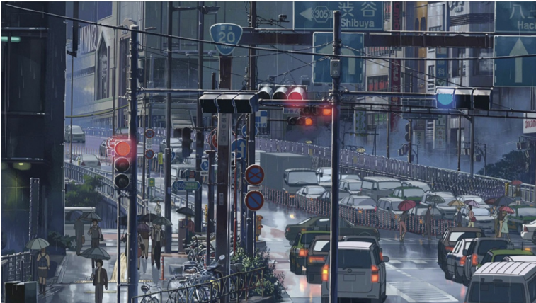
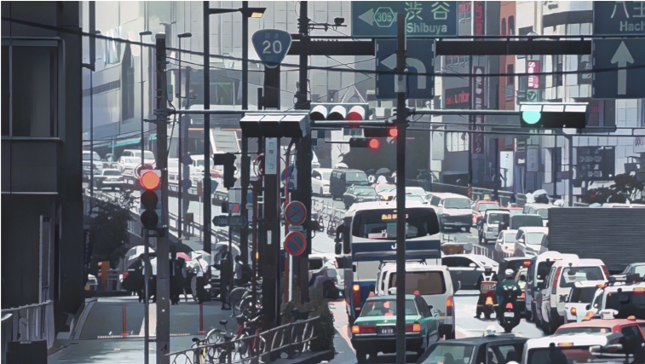
A frame in animation “Garden of words”
B. A real photo processed by WBC method
Comparison between a real cartoon image and an image processed by our method.

Slide 3
ABSTRACT
We propose to implement a new framework for estimating generative models via an adversarial process to extend existing GAN framework and develop a white-box controllable image cartoonization, which can generate high-quality cartoonized images from real-world photos.
We suggest to separately identify three white-box representations from images: the surface representation that contains a smooth surface of cartoon images, the structure representation that refers to the sparse colour-blocks and flatten global content in the celluloid style workflow, and the texture representation that reflects high-frequency texture, contours, and details in cartoon images.
The learning objectives are separately based on each extracted representations, making our framework controllable and adjustable. The project will demonstrates the potential of the framework through qualitative and quantitative evaluation of the generated samples.

Slide 4
INTRODUCTION
Cartoons are a very popular art form that has been widely applied in diverse scenes, from publication in printed media to storytelling for children. Some cartoon artwork were created based on real world scenes. However, manually re-creating real life based scenes can be very laborious and requires refined skills.
The evolution in the field of Machine Learning has expanded the possibilities of creating visual arts. Some famous products have been created by turning real-world photography into usable cartoon scene materials, where the process is called image cartoonization.
White box cartoonization is a method which reconstructs high quality real life pictures into exceptional cartoon images using GAN framework.

Slide 5
LITERATURE SURVEY
Cartoonization is itself a classic art but the evolution in the field of Artificial Intelligence has opened many opportunities. Many models have been developed to generate cartoon images from pictures, but have many drawbacks.
CartoonGAN is one of the technology to generate cartoonized images but it adds noise and reduce quality of image. On the other hand White Box Cartoonization overcomes these problems and results in more precise and sharp images.
This project will be based on the model proposed by Xinrui Wang and Jinze Yu - Learning to Cartoonize Using White-Box Cartoon Representations. The main objective of this project is to develop modern cartoon animation workflows which allow artists to use a variety of sources to create content.

Slide 6
PROBLEM STATEMENT
AI-powered cartoonization has many practical applications these days — from personalized anime-style avatars to video and even fine art. Many black-box cartoonization frameworks however provide users with limited control or adjustability when rendering real-world photography into cartoon scenes.
So we are proposing a less arduous web app capable of cartoonize images with lots of precision and accuracy just by given the input image into a GAN framework which will give as an output a cartoon image.

Slide 7
OBJECTIVES
The objectives of this project are:
Develop modern cartoon animation workflows which allow artists to use a variety of sources to create content without the need of drawing.
Deploy GAN framework and create a Web application that can convert any images into high quality cartoon images by simply uploading the picture online and getting the cartoon image.

Slide 8
SCOPE
Generative Adversarial Networks (GAN) have attained remarkable results in image enhancement and augmentation. Currently, our project focuses on the cartoonization of high-quality images.
Further, deep work and development in this white box cartoonization can lead to many various applications:
Generates quick prototypes or sprites for anime, cartoons and games.
Since it subdues facial features and information in general, it can be used to generate minimal art.
Games can import shortcut scenes very easily without using motion-capture.
Can be modelled as an assistant to graphic designers or animators.

Slide 9
GAN-TREE: A GAN FRAMEWORK FOR GENERATING DIVERSE DATA
Generative Adversarial Networks (GANs) are a class of Neural Networks, which can be used for modeling the underlying data distribution from a given set of unlabeled samples.
GAN comprises of two competing networks, a generator, and a discriminator.
The generator learns to map a random vector to the high dimensional data such as image, while the discriminator network learns to discriminate between the real and the synthesized samples.
Finally, this competition leads to the generation of realistic samples, which are undiscriminating to human observers. These models are of prime importance in modern AI research with enormous potential towards realizing Generalized AI.

Slide 10
WHITE BOX CARTOONIZATION
We propose to separately identify three white-box representations from images:
The surface representation
The structure representation
The texture representation
The surface representation that contains a smooth surface of cartoon images.
The structure representation that refers to the sparse color-blocks and flatten global content in the celluloid style workflow.
The texture representation that reflects high frequency texture, contours, and details in cartoon images.
A Generative Adversarial Network (GAN) framework is used to learn the extracted representations and to cartoonize images.

Slide 11
TIMELINE
Comprehension of Mathematical concepts and Algorithms
Start with the deployment of WBC Model
WEEK 1
WEEK 3
WEEK 5
WEEK 7
WEEK 9
Research Paper
Start with the implementation of WBC Model
Prototype Developed Successfully
Reading and collecting relevant information.
Defining Requirements.

Slide 12
THANK YOU

